Slide 1
Ped Grand Rounds – New Attendance Logging Rules
Powered by:
IMPORTANT:
There is an exciting, but big change to how you will log your attendance for Grand Rounds and other academic conferences.
The UCLA Center for Continuing Professional Development (CCPD) has stated we need to use a new system (CloudCME) to log attendance starting 2/2/24.
You will now only be able to log attendance using your phone via CloudCME app or text message.
This information will be stored on the CloudCME website or app for viewing only.
You can only log attendance once you have set up your CloudCME profile via app or their website.
If you do not install the app, you will need to log attendance via the text messaging option.
Qualtrics will no longer be used to record attendance for CME credit or Good Standing.
Please utilize the below slides to review how to access your CloudCME Portal, Attendees’ Portal, Profile Set-up, CE Transcripts, and Virtual Conference Check-In via text or QR code.
Grand Rounds Attendance
You can now only log attendance using your phone. There are two ways to log attendance (a QR code or via text message using your phone) – you will NOT be able to log attendance through the actual CloudCME website, but you can only log attendance once you’re registered on CloudCME (via app or website).
If you want to log attendance via text you need to enter your cell phone number during registration (you do not need the app in this case)
If you want to log attendance using the QR code, you will need to download the app. You cannot simply scan the QR code with your phone to log attendance if you do not have the app.
You do NOT have to complete an evaluation to receive credit.
Please see the next slides for further instructions on how to register and sign-in to CloudCME.
***Participants must record attendance during or within 2 hours after Grand Rounds to receive credit for both CME credits and the Good Standing metric. Attendance will NOT be retroactively recorded, thus it is imperative you create your account, set-up your profile, and download the mobile app prior to the start of the session.

Slide 2
Register and Sign-In
&
Profile Set-up

Slide 3
Powered by:
Register/Sign-in to Attendee CME Portal: via web
We encourage you to check out our new portal and explore its features! Here are the instructions on how to log in using your account.
Register with/Sign In to CloudCME (via web):
Link to the new portal: https://ucla.cloud-cme.com/default.aspx
UCLA, UCLA Health, Harbor-UCLA, and VA Employees: Please Sign In with SSO Credentials.
All Other Guest Faculty/Planners: Please sign in with your email or create an account with your Email.*
Click the My CME button from the top menu and Registration & Receipts to view your past and future registration.
*You may have an account in the portal if you've registered for previous courses with CCPD. In this case, please utilize the "forgot your password?" feature to reset your password.
How to reset your password:
Visit our Cloud CME platform login page (https://ucla.cloud-cme.com/default.aspx).
Click on the "Forgot your Password?" button.
Enter the email address associated with your account.
You will receive an email with instructions on how to reset your password. Follow these steps to create a new password.
Once your password is reset, return to the login page and enter your email and new password to access the attendee portal.

Slide 4
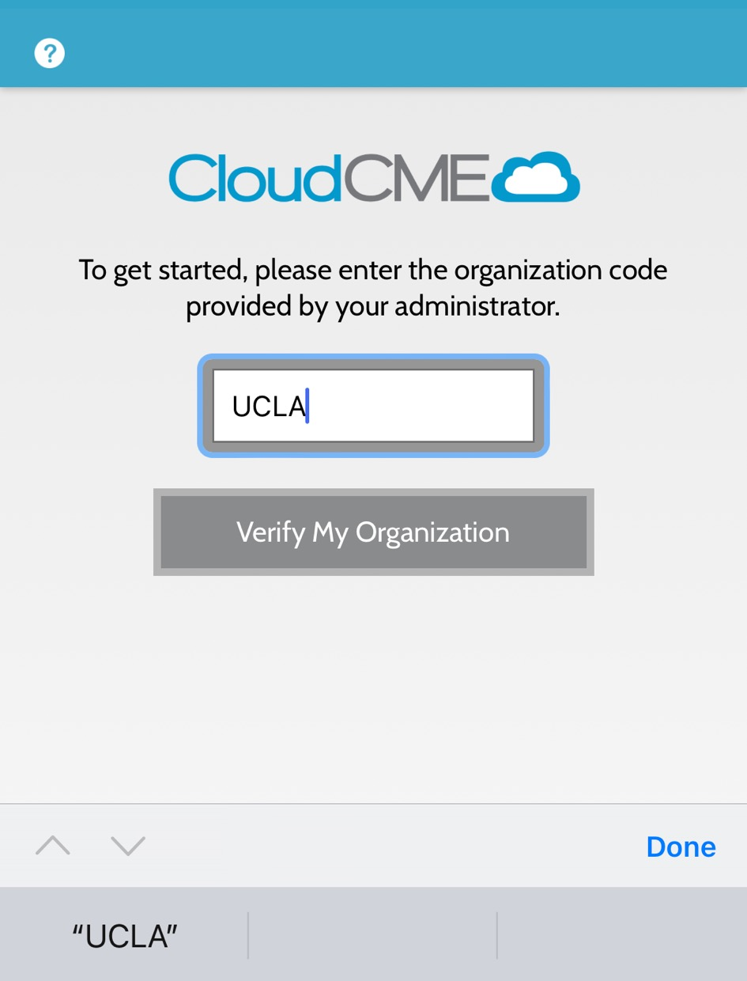
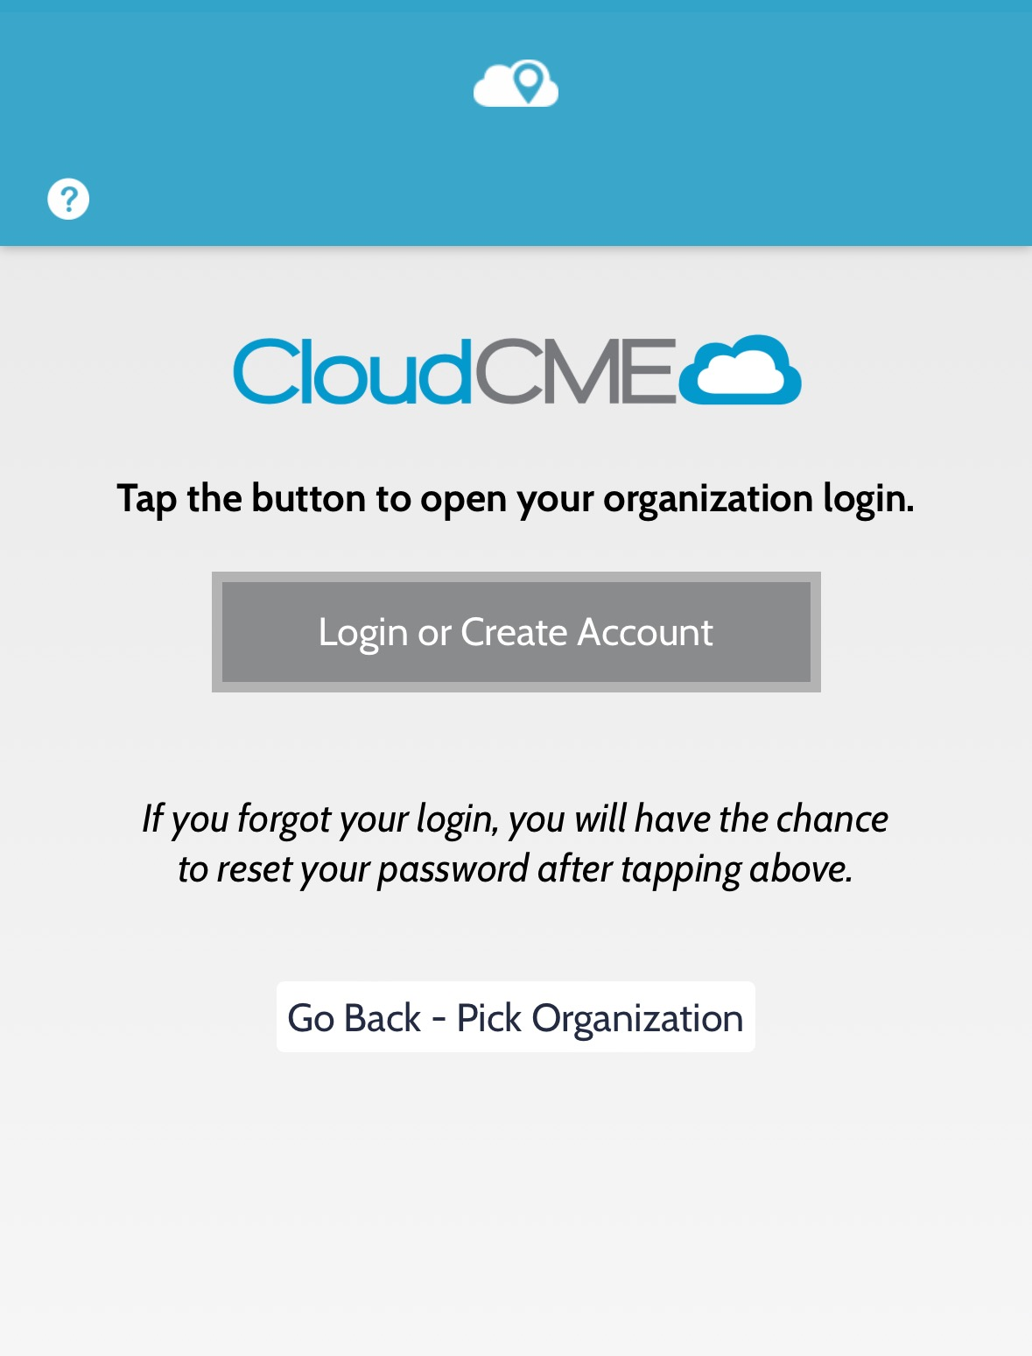
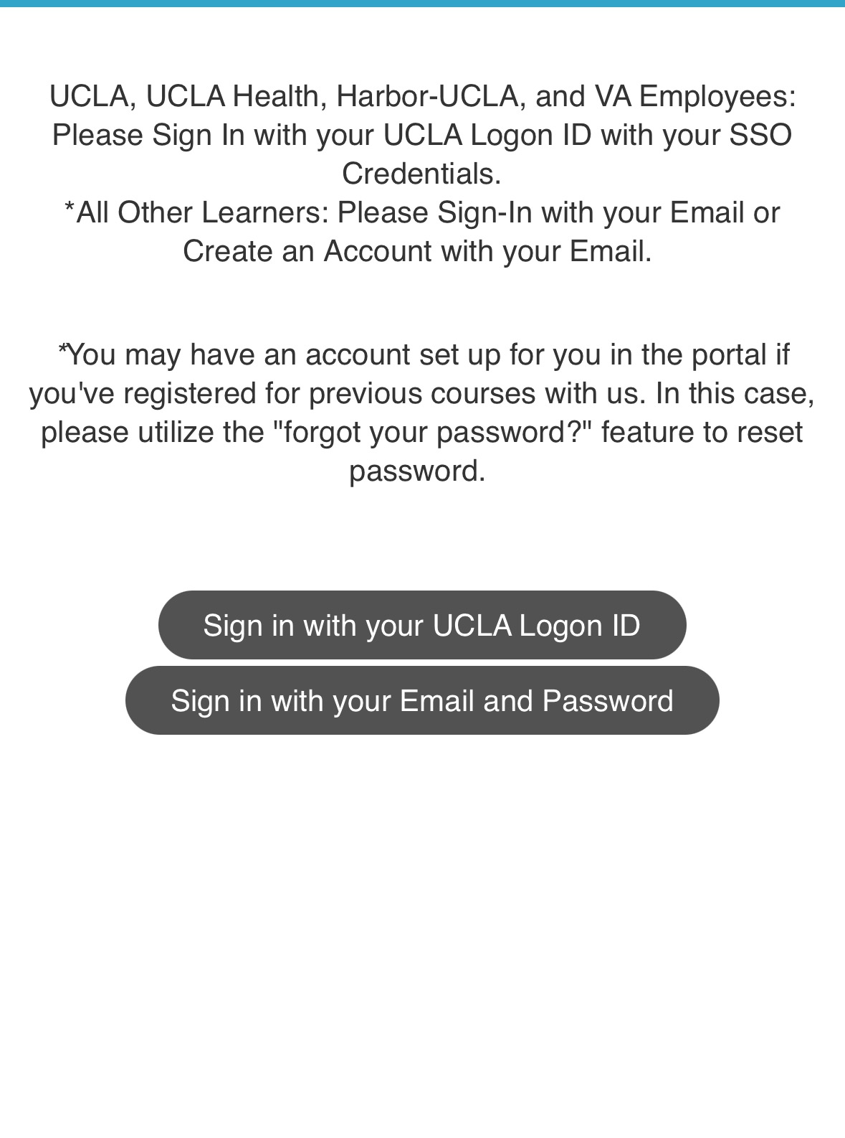
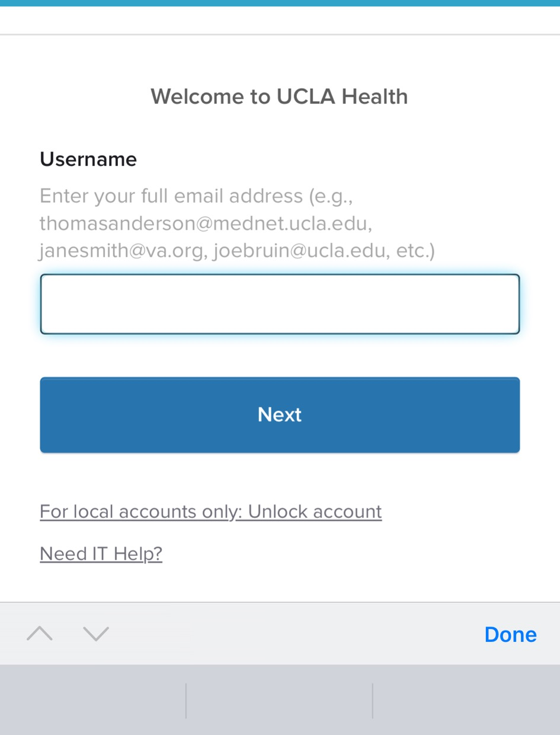
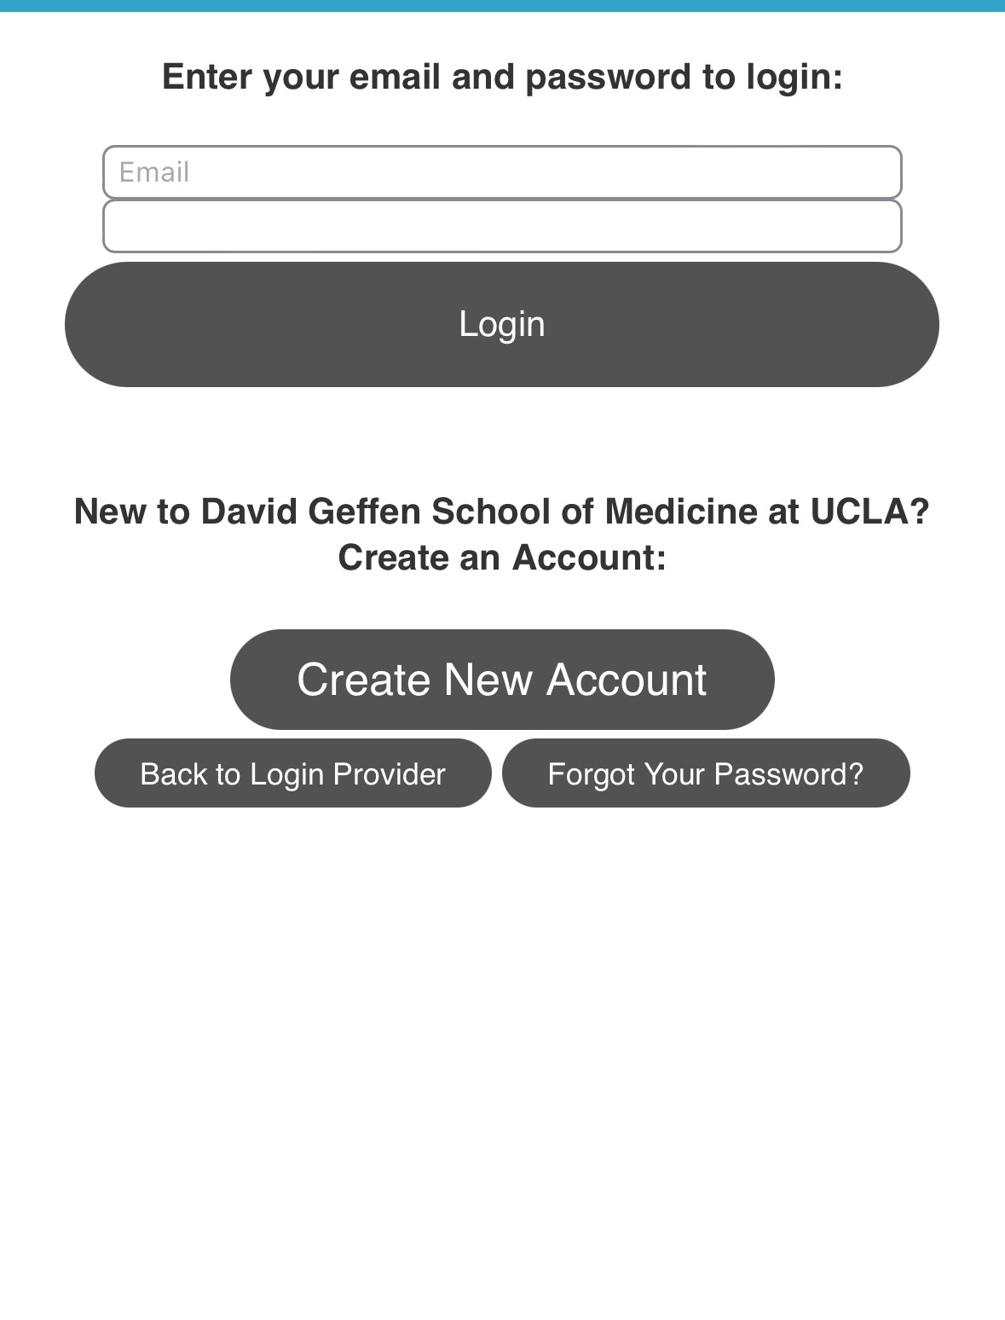
Register/Sign-in to Attendee CME Portal: via app
Powered by:
CloudCME Mobile App:
Register/Sign-in instructions:
Download the app from your mobile
Enter organization code: “ucla”
Click Login or Create Account
Sign in using your username and password
UCLA, UCLA Health, Harbor-UCLA, VA Employees
Enter Organization Code
Click Login or Create Account
Select Sign in Option
All Other Learners

Slide 5
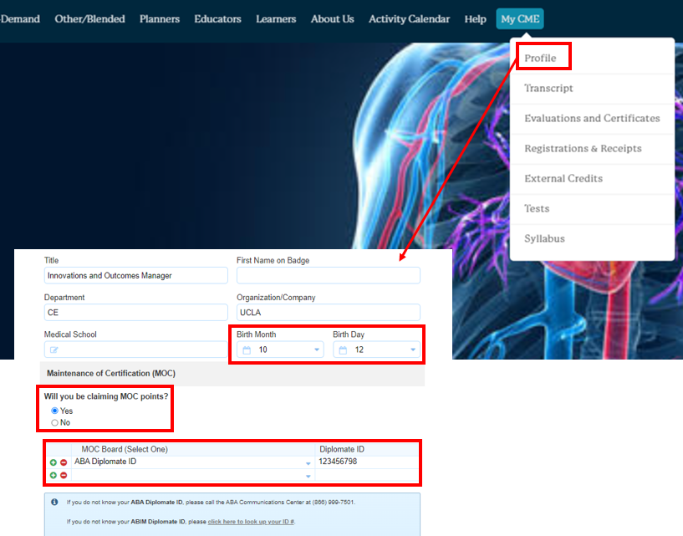
Powered by:
Profile Set-Up
Instructions:
Link to the new portal: https://ucla.cloud-cme.com/default.aspx
Click on the “My CME” button from the main menu bar and click “Profile”
Update your profile information
*If you intend to claim MOC points for the courses that are registered for MOC Part II, provide your birthdate and the board information in MOC section

Slide 6
Attendance
Login Options
Two options: QR Code via App or Text

Slide 7
Powered by:
Virtual Conference – Log Attendance (via text)
Via Text Message:
Session Course ID: SAMPLE
Pair your mobile number to your account: Text your email address to (866) 875-4686.
You will receive a text notification indicating your phone number has been updated.
Send the course ID above via text to (866) 875-4686.
Please note, that texting attendance can only be recorded 60 minutes prior to the course start time, during the course, and up to 120 minutes after the course end time.
If you encounter any issues, please email ccpd@mednet.ucla.edu.

Slide 8
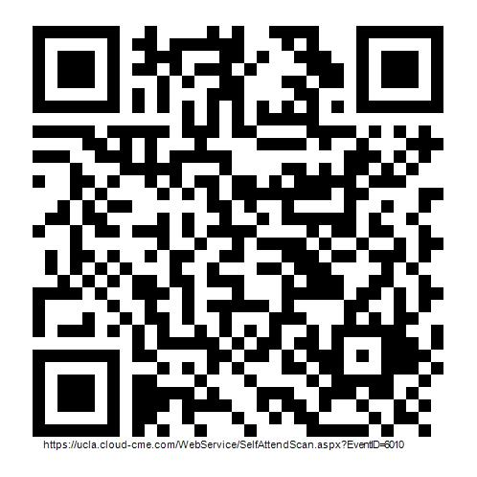
Virtual Conference – Log Attendance (via app)
Powered by:
Via QR Code using CloudCME Mobile App:
Download the app from your mobile
Enter organization code: “UCLA”
Sign in using your username and password
Click “Scan Attendance”
Scan the QR code
THIS IS SAMPLE
REPLACE QR CODE
Please note, that attendance can only be recorded 60 minutes prior to the course start time, during the course, and up to 120 minutes after the course end time.
If you encounter any issues, please email ccpd@mednet.ucla.edu.

Slide 9
CloudCME Features

Slide 10
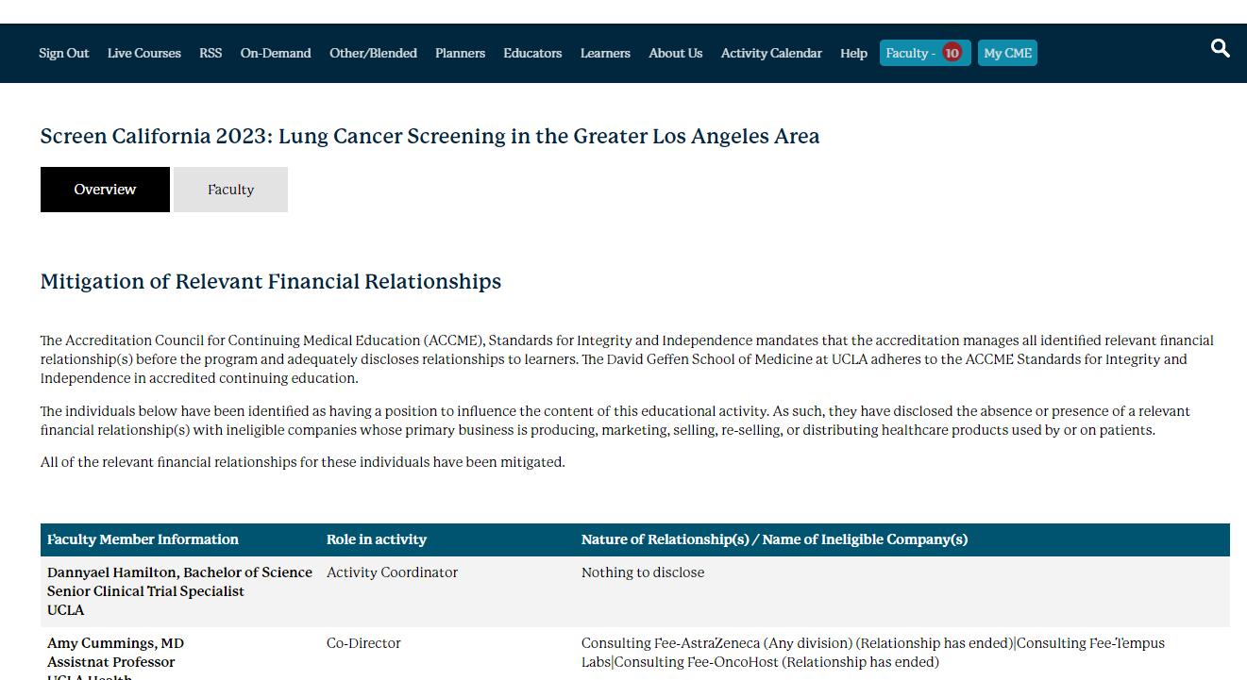
Powered by:
Continuing Education (CE) Accreditation and Disclosures
Review the accreditation information and disclosures for individuals identified as having a position to influence the content of this educational activity.
Link to the course page: Click Here
Click on the “Overview” tab to review course information including accreditation statements
Click on the “Faculty” tab under the course title to review disclosures

Slide 11
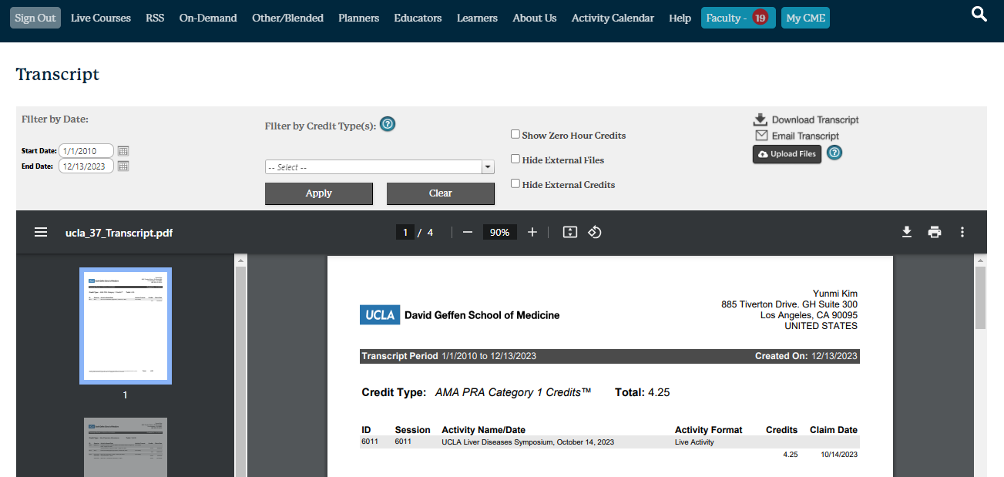
CE Transcript – to view attendance only
Powered by:
Instructions:
Follow the link: https://ucla.cloud-cme.com/default.aspx
Click the “My CME” button from the main menu bar
Click “Transcript” button

